Slide 1
Apache SPARK fundamentals

Slide 2
Agenda
Overview of job execution in Hadoop map reduce
Recap of the drawbacks in map reduce
Overview of spark architecture
Spark deployment
Job execution in SPARK
RDD’s
Actions and transformations
Demo

Slide 3




Overview of job execution in HADOOP
Name node
Resource manager/YARN
Data nodes
Job client
Name node
A job submitted by the user is picked up by the name node and the resource manager
Job gets submitted to the name node and eventually resource manager is responsible for scheduling the execution of the job on the data nodes in the cluster
The data nodes in cluster consists the data blocks on which the user’s program will be executed in parallel

Slide 4
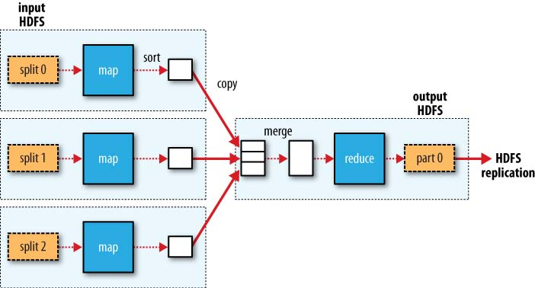
The map and reduce stage
Notes:
4

Slide 5
SPARK’s approach to problem solving
Spark allows the results of computation to be saved in the memory for future re-use
Reading the data from the memory is much faster than that of reading from the disc
Caching the result in memory is under the programmer’s control
Not always is possible to save such results completely in memory especially when the object is too large and memory is low
In such cases the objects needs to be moved to the disc
Spark, therefore is not a completely in memory based parallel processing platform
Spark however is 3X to 10X faster in most of the jobs when compared to that of Hadoop

Slide 6
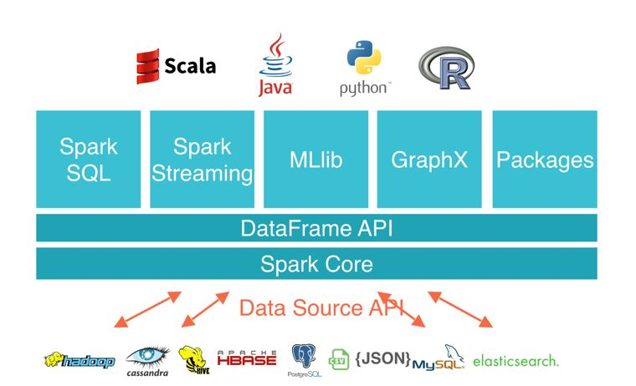
Understanding SPARK architecture

Slide 7
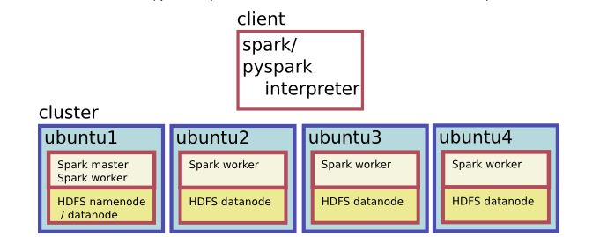
Spark cluster on Ubuntu host machines

Slide 8
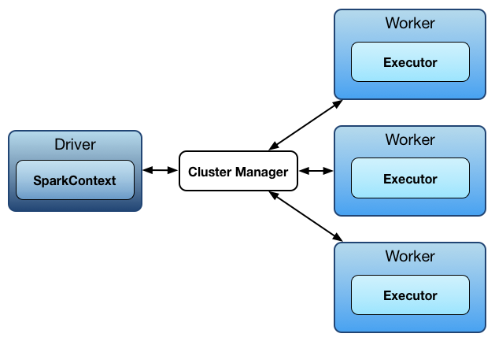
Simplifying SPARK architecture
Driver is the starting point of a job submission (this can be compared to the driver code in Java MR)
Cluster Manager can be compared to the Resource Manager in Hadoop
Worker is a software service running on slave nodes, similar to the are the data nodes in a HADOOP cluster
The executor is a container which is responsible for running the tasks

Slide 9
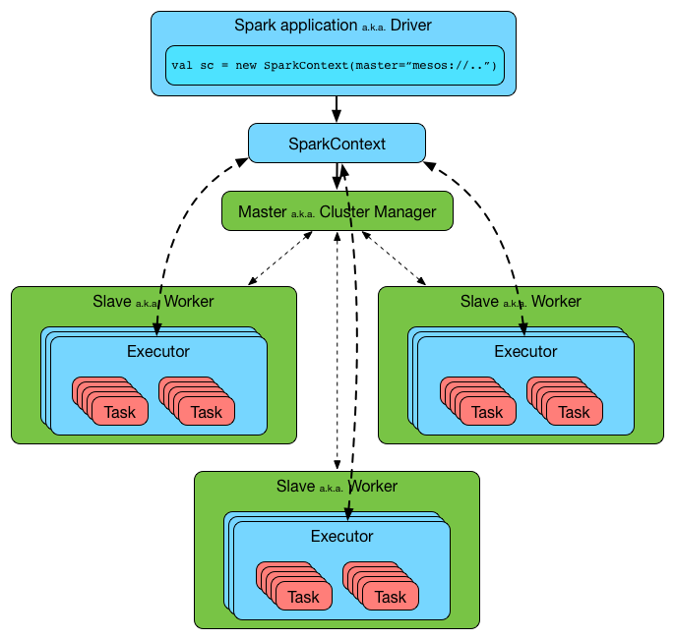
Job execution in a SPARK cluster

Slide 10
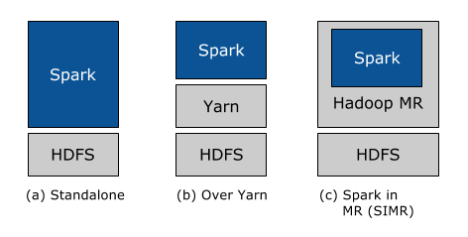
Spark deployment modes
Image courtesy : https://databricks.com/blog/2014/01/21/spark-and-hadoop.html

Slide 11
Spark deployment modes
Standalone mode :
All the spark services run on a single machine but in separate JVM’s. Mainly used for learning and development purposes(something like the pseudo distributed mode of Hadoop deployment)
Cluster mode with YARN or MESOS:
This is the fully distributed mode of SPARK used in a production environment
Spark in Map Reduce (SIMR) :
Allows Hadoop MR1 users to run their map reduce jobs as spark jobs

Slide 12
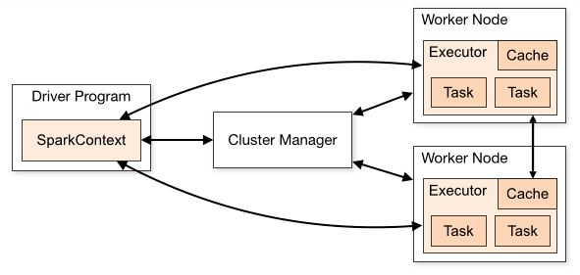
Caching the RDD’s

Slide 13
3 different ways of creating an RDD in SPARK
Created by read a big data file directly from an external file system, this is used while working on large data sets
Using the parallelize API, this is usually used on small data sets
Using the makeRDD API

Slide 14
Actions and transformations
Transformations are any operations on the RDD’s which are subjected to manipulations during the course of analysis
A SPARK job is a collection of a sequence of a several TRANSFORMATIONS
The above job is usually a program written in SCALA or Python
Actions are those operations which trigger the execution of a sequence of transformations
There are over 2 dozen transformations and 1 dozen actions
A glimpse of the actions and transformations in SPARK can be found in the official SPARK programming documentation guide
https://spark.apache.org/docs/2.2.0/rdd-programming-guide.html
Most of them will be discussed in detail during the demo

Slide 15
Summary
A quick recap about the drawbacks of Map-Reduce in Hadoop
Spark architecture
Spark deployment modes
Job execution in SPARK
RDD’s

